Slide 1
Doing Business in Odisha
Industrial and Investment Scenario
16 October 2020

Slide 2
Contents
Odisha’s Industry-driven economy
Infrastructure – led industrial development
Dedicated Vision for Industrial Growth
Odisha as an investment destination
Sector-Specific Opportunities for companies
Governance to support Industrial Growth

Slide 3
Odisha’s Industry-driven economy
Higher than national average growth in GDP over the past 5 years
16-fold increase in employment potential through industries in the past 6 years
Services and Industries are the two largest sectors contributing to the State GDP with 40.5% and 39.06% respectively
#1 State in India in terms of attracting investments during Apr -Sep 2019 as per Centre for Monitoring Indian Economy (CMIE)
3
Odisha: Industrialized state with huge growth potential

Slide 4
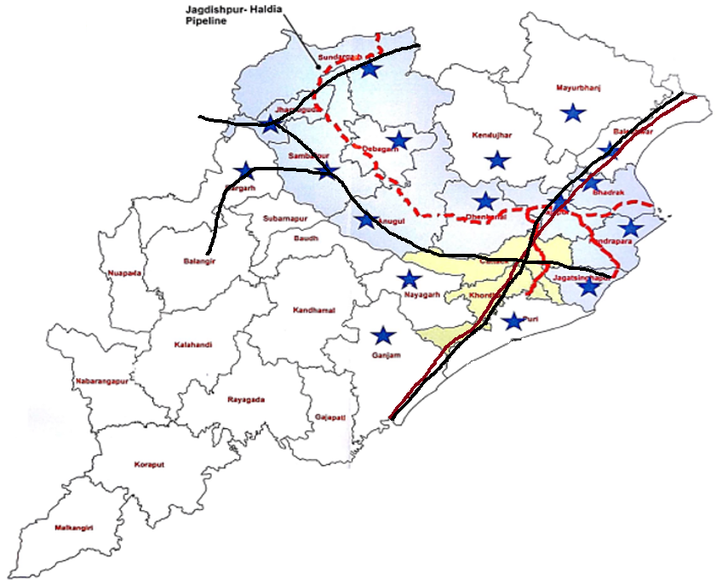

Infrastructure – led industrial development
Home to Paradeep port: 1st in Average Output Per Ship Berth-day in India and 2nd in capacity and quantity of Traffic Handled in India
Dhamra Port: Deep draught all-weather port, second largest private port on the Eastern coast
Subarnarekha Port
Dhamra Port
Paradip Port
10,000 km of Highway Network along with a mesh of Railways providing connectivity to the Indian hinterland
Gopalpur Port
 | Gas Pipeline
 | National Highway 16
 | Railway Network
 | Gas Distribution Centres
11 % of India’s water resources and power surplus with over 17,600 MW of production
4
Odisha: Consistently amongst the top investment destinations in India

Slide 5
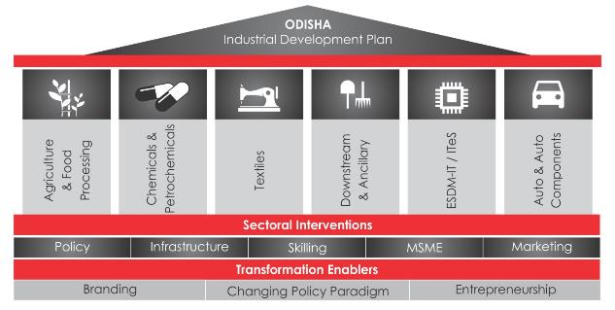






Dedicated Vision for Industrial Growth
“State’s Vision is to attract Rs 2.5 lakh crore of new investments in 6 identified focus sectors and create
3 million job opportunities by 2025”
Odisha Industrial Development Plan: Vision 2025
Food Processing including sea food
Chemicals, Plastics & Petro chemicals
Ancillary & Downstream industries in Metal sector
Tourism
Textiles & Apparel
ESDM-IT/ITeS
5
Textiles and Apparel: Recognized as a focus sector for the State

Slide 6






Odisha: As an investment destination
Dedicated authority to facilitate skill development for industries
A cost-effective and hassle-free destination for industrial investments
Odisha has one of the lowest* cost of doing business in India, with:
Lowest industrial electricity tariffs
Low industrial land cost
Low water tariffs
Competitive skilled labour wage rate
More than 170,000 graduates every year from 950+ training institutions in Odisha
Globally recognized Institutes of Higher Learning & Research including CIPET, Institute of Chemical Technology (ICT), IIT, NIT and Institute of Textile Technology
Abundant availability of skilled workers; additional skilled manpower availability post COVID-19
Development of first-of-its kind World Skill Centre at Bhubaneswar
Vision of OSDA:
Odisha’s Best, World’s Next
*As per a report by Asian Development Bank (ADB)
First-of-its-kind single window system which supports industries throughout their investment lifecycle
Recognised as a best practice by Government of India
Odisha: Enabling industrial ecosystem supported by skilled manpower

Slide 7
Sector-Specific Opportunities for companies – 1/2
Technical Textiles Park, Bhadrak
Snapshot Of Sector-specific park:
Development planned over 100 acres
Anchored by a 300 KTPA capacity polyester plant by Indian Oil Corporation (IOCL) with committed feedstock of:
  Polyester Staple Fibre (PSF) – 100 KTPA
  Drawn Texturized Yarn (DTY) – 167 KTPA
  Fully Drawn Yarn (FDY) – 33 KTPA
Factory-door availability:
  Road connectivity to National Highway
  Electricity through dedicated 33/11 KV sub-station
  Water supply by State Industrial Development Corporation
Technical Texiles Park, Bhadrak
Dhamra Port
Bhubaneswar
Paradip Port
Gopalpur Port
Dhamra Port | 60 km
Bhadrak Railway Station | 16 km
Biju Patnaik International Airport | 128 km
National Highway 16 | Adjacent
Dedicated plug-and-play parks for textiles and apparel industries

Slide 8

Sector-Specific Opportunities for companies – 2/2
Odisha Textiles Park, Dhamra:
Port-based mega textile park to enable export of finished goods
Area: 1,000 acres | Plots: 450 (0.3 – 2.5 acres)
Investment Potential: INR 6,500 crore | Employment Potential: 20,000
Dhamra Port | 10 km
Railway Siding at Dhamra Port | 10 km
Biju Patnaik International Airport | 173 km
National Highway 16 | 65 km
Dhamra Port
Bhubaneswar
Odisha Textiles Park, Dhamra
Textiles Park, Malipada
Paradip Port
Textiles Park, Malipada:
Textile park in the district producing highest skilled textiles workers
Gopalpur Port
Area: 800 acres | Plots: 400 (0.3 – 2.5 acres)
Investment Potential: INR 6,000 crore | Employment Potential: 18,000
Paradeep Port | 125 km
Bhubaneswar Railway Station | 15 km
Biju Patnaik International Airport | 30 km
National Highway 16 | 10 km

Slide 9
Odisha: Governance to Support Industrial Growth
Even in these trying times, the state’s focus on industrial growth has not diminished
All large industries operational; 85% MSMEs operational; production levels ~ 80% as indicated by consumption of electricity, movement of railway freight and port cargo
  Large Investments: Approved by the state since Feb 2020:
  No. of projects: 36
  Investment: INR 24,299 crore
  Employment Potential: 19,162
  MSMEs: Under ECGLS, around Rs 2,900 crore sanctioned to 1.65 lakh units, employment for 16 lakh people
Odisha: Supporting industries in all situations and enabling growth

