Slide 1

Emerging Role of Packaging for Apparel Sector
Dr. Tanweer Alam
Director
Indian Institute of Packaging

Slide 2
ABOUT IIP
An Autonomous Body – under administrative control of Dept. of Commerce. Established in 1966 registered under Societies Registration Act, 1860.
Headquarters & Principal Laboratories in Mumbai Headed by Director
Institute is fully self sustainable for its recurring expenses. Meets recurring expenses through various services provided to packaging & allied industries.
Dept. of Commerce has been providing financial assistance for Capital expense through various schemes since 8th Five Year plan.
CSR ranked Tope Packaging Institute in the Country. According to WPO IIP ranked second best Institute in world.
MANDATE OF IIP
To promote exports by way of innovative package design & development.
To support packaging industry through technical services: research, testing & certification.
To meet the needs of technical manpower in the packaging industry through packaging education & training.
To Upgrade the overall standards of packaging & formulate new standards.

Slide 3
ROLE OF IIP FOR PROMOTION OF PACKAGING
Development of domestic packaging standards: IIP has formulated 46 standards for packaging of fresh vegetables & fruits for NAVY. In addition, 11 packaging standards are being developed for Spices Board, DoNER, TRIFED & IRCTC etc.
Formulation of export packaging standards: Developed 21 export packaging standard for fruits & vegetables for APEDA.
Development of package design: Developed package designs for enhancing the shelf life for 4 ethnic foods like, Kasundi, Honey & Jaynagar Moa etc.
Over All more than 150 packaging standards are being in recent times.

Slide 4
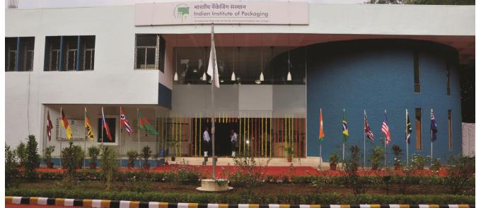
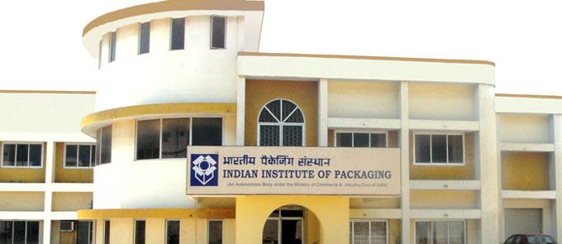

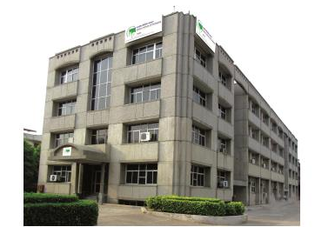
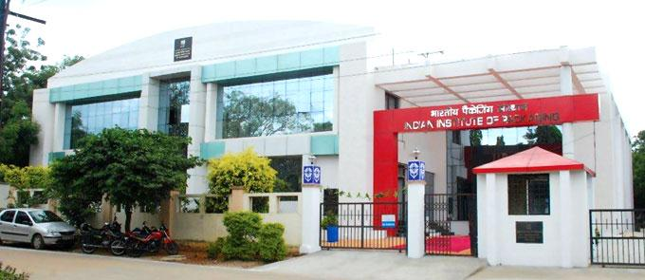
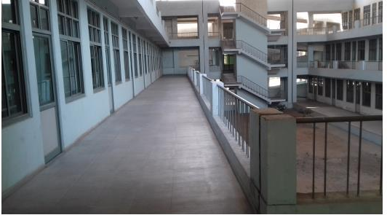
IIP CENTRES
IIP - MUMBAI
IIP - CHENNAI
IIP - KOLKATA
IIP - DELHI
IIP - HYDERABAD
IIP - AHMEDABAD

Slide 5
ACTIVITIES OF IIP
ACTIVITIES OF IIP
Publication
Training & Education
Testing & Certification
Research & Development
Exhibition & Conferences
Consultancy

Slide 6
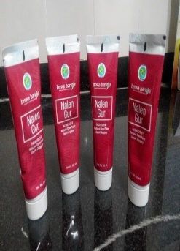
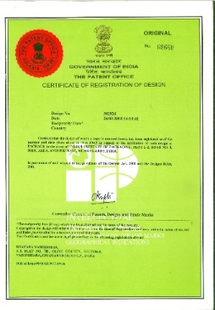
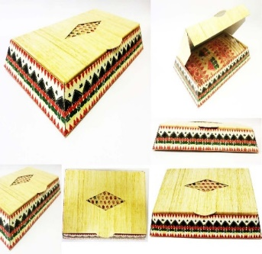
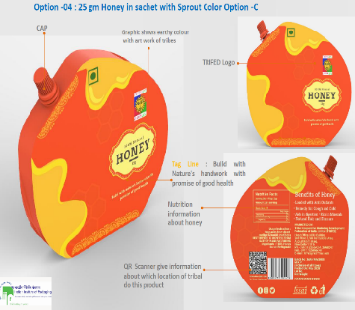
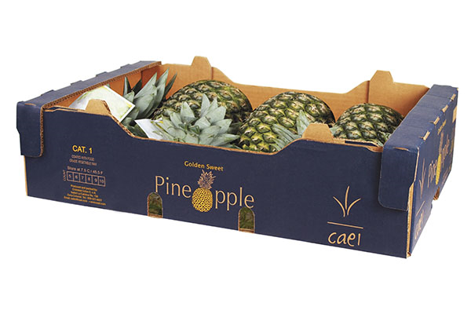
INNOVATIVE & AESTHETIC PACKAGING FOR MSME, HANDICRAFT & GI PRODUCTS
Development of innovative package design for liquid Jaggery (Nalen-Khajur Gud)
The Shelf Life of Nalen Gud has increased from 5 hrs. to 92 days & it is marketed by Biswa Bangla at Kolkata airport &other imporium
Package Design Developed for Tribal Cooperative Marketing Development Federation of India (TRIFED) during the Lockdown .
PACKAGING DEVELOPMENT FOR PINEAPPLE

Slide 7
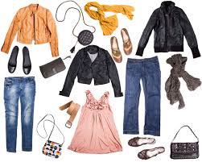
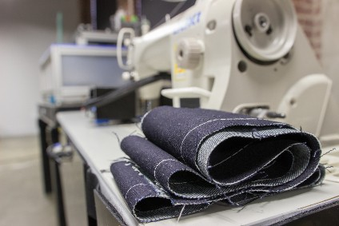
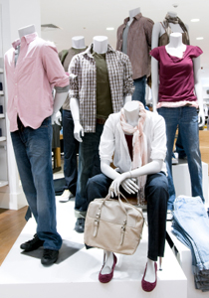
About Apparel Industry
Apparel Industry - considered as one of the most unique industries universally
48% of online shoppers search for apparel category
After completing manufacturing task, apparel - required to be packed.
After packing, it is placed in cartons for storage & delivery.

Slide 8
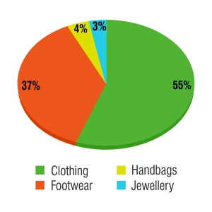
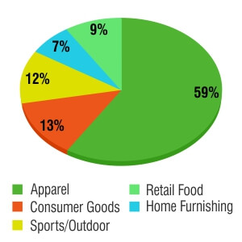
Apparel Industry
Product Wise Sales in Indian e-Commerce Industry:
Fashion and Apparel e-Commerce Industry Statistics:

Slide 9
Why packaging is important for a Apparel?
Packaging performs basic functions:
  Protection /Containment
  Preservation/Longevity/
  Promotion /Information
  Marketing tool /Sale/ /Branding
  Transportation
  Utility of use/Value addition
Protection against tear
Protection against weather or moisture / dust / UV protection
Safety from losing form especially in case of stiff apparel like coats or blazers or footwear

Slide 10
Role of Product Packaging
52% consumers will buy the product again if they get the product in premier packaging.
90% consumers are bound to use the packaging boxes and bags after purchase.
These statistics are proof enough that product packaging is the need of the hour and retailers cannot stand oblivious to the urgency of good product packaging if they want to create brand perception & earn revenues.

Slide 11
Product Packaging…
Two basic objectives of packaging - preventing any damage to the product during transportation & enhancing the features of the product to the consumer for a sale of it.
Packaging has two major functions for Apparel Industry
Distribution: Main purpose of distribution packaging - allows the garment manufacturers to transport the garment at a minimum cost & in the shortest time without deteriorating the quality of the product.
Merchandising/Sale: The merchandising function - showcasing the garment product in a way that it stimulates consumer desire for purchasing the particular product.

Slide 12

Basic Operation of Garment Packing
Flowchart of Garment Packaging:
Received garments from the finished section
↓
Hang tagging
↓
Folding with inserting back board, tissue
↓
Poly Bagging
↓
CFB/Woven Sack
↓
Applied adhesive tape on the pack
↓
Bar-coding
↓
Packing complete

Slide 13
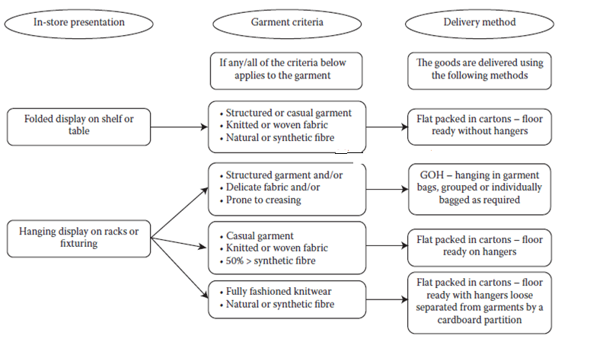
Type of Garment Packaging

Slide 14
Packing Materials
Common Packaging materials used in garment and related items are paper, plastic, film, wood, nails, staples, cords, gum tape & metal bands.
Wood cases & crates are generally used as packing materials for bulk exports during shipment.
Paper & plastic film materials – commonly used packaging materials garment industries.
Paper types such as kraft, crepe, tissue, paper foil, paper board & waterproof are typically used as packing materials.
Plastic films - major advantage over paper because of clarity in range.
Types of Package Forms: Basic types of package forms used in apparel and allied products are:
  Bag in box
  Folding cartons
  CFB
  Crates
  Wrappers/PE/Bleached Craft Paper

Slide 15
Quality Specifications for Packaging Materials:
The basic quality factors /parameters for Apparel Packaging
Properties:
  Transparency / See through/ Clarity
  Thickness
  Dimension: Width and length
  Weight
  Yield
Characteristics
  Tensile strength/BS/
  Elongation
  Bursting and tearing strength
  Flammability
  Porosity
  Air/moisture permeability
  Sunlight transference
  Resistance to odours
  Dimensional stability to heat and sunlight
A quality impression is a vital sales requirement for packaging because the products that are perceived to be of low quality are normally believed to be a low value, regardless of cost

Slide 16
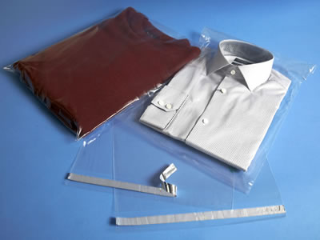
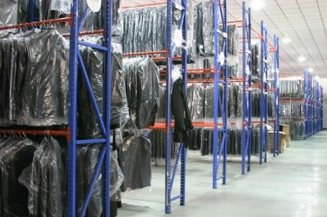
Most commonly Used Types of Garment Packing are given below
Stand-up pack: This type of packing is commonly used for shirts and hence termed as ‘shirt packing. It is an attractive pack so it enhances the appeal of the garments to the customer
Flat pack: Garments are pressed and folded well as like in a stand-up pack
Hanger pack: Packing method where the garments are secured in a poly bag with a hanger after pressin
Deadman pack: It is a simple packing method using only pins or clips and polybags.

Slide 17
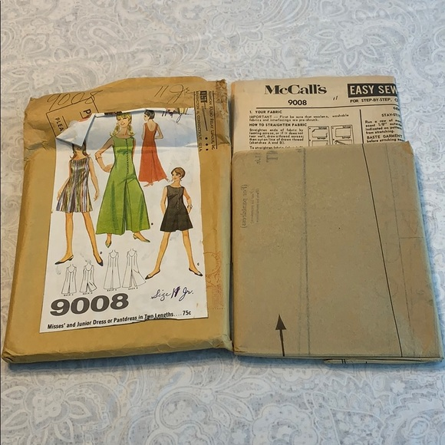
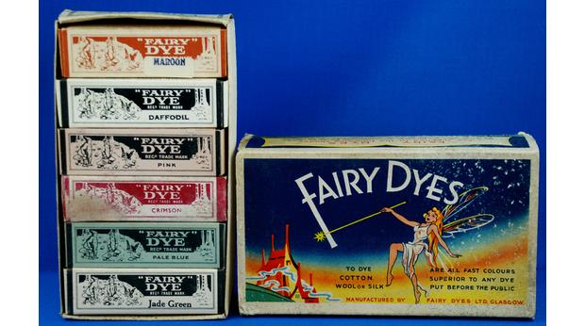
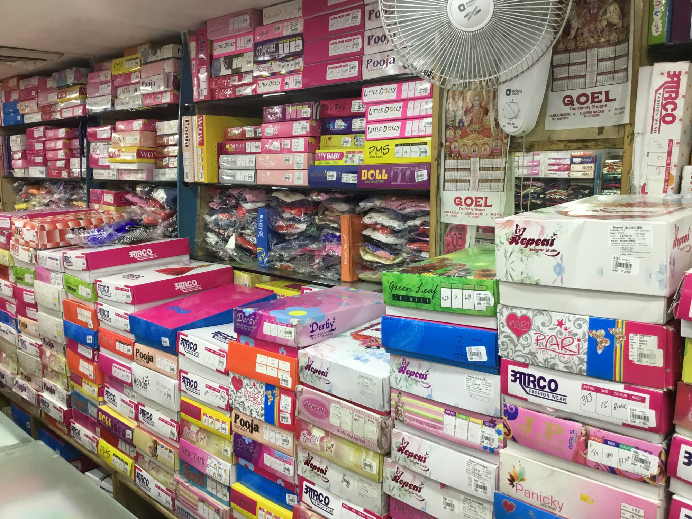
Ancient & Traditional Apparel Packaging
1960-71…

Slide 18
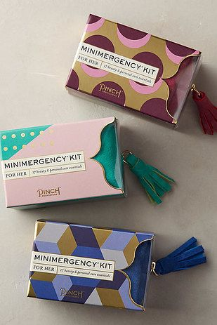


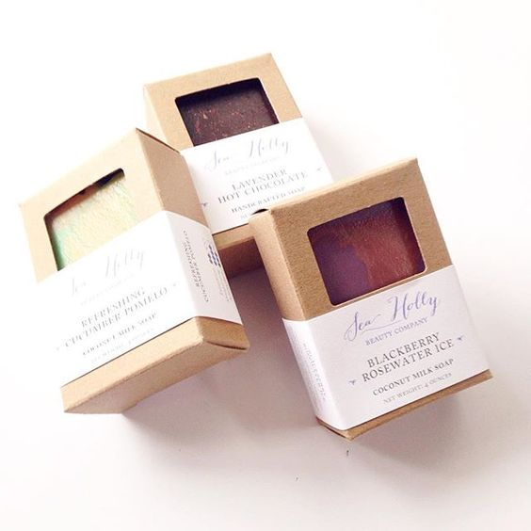
Modern Role of Packaging Innovative Design…
Two main criteria for package design are functional & sales requirements.
Designing of packages to look as good as possible without misrepresenting the actual product contents.

Slide 19
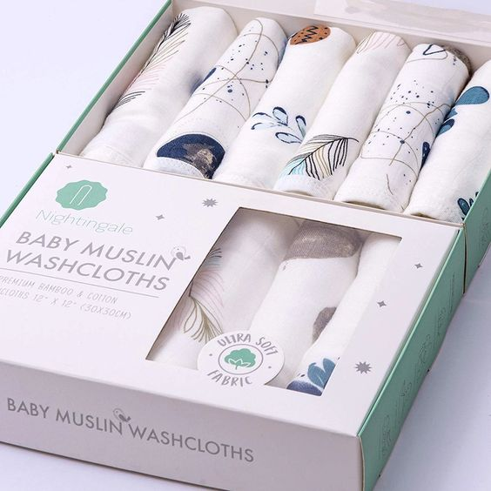
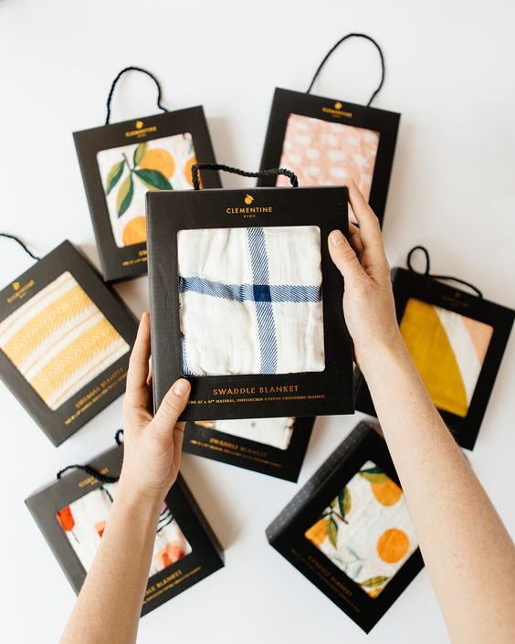
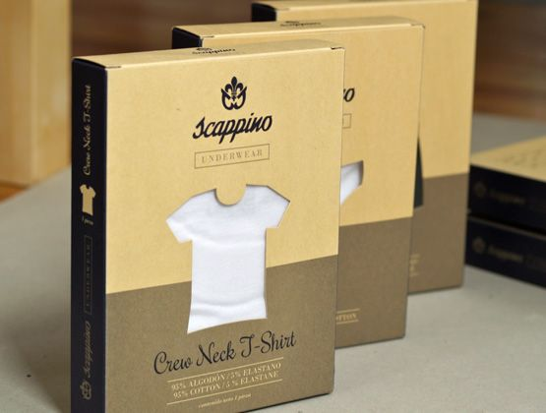
Packaging must draw the attention of the buyer, identify the product and differentiate it from the competition, & attempt the customers to purchase the product.
By using larger package sizes and displaying the brand name in the visible portion of the package.

Slide 20
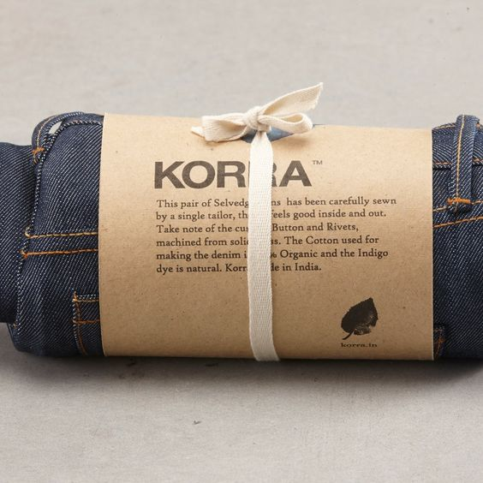
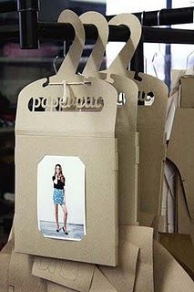

Package must reusable options of the package to the consumer

Slide 21
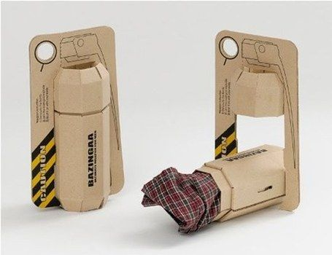

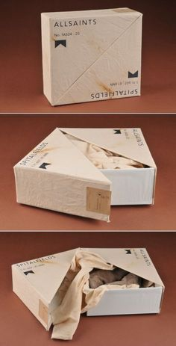

Premium Package in Retail Market
Sustainable, attractive & reusable
Package must be attractive, exciting, soft, intriguing, or to evoke some other emotion.
Normally bright colors, prominent carton displays & other elements can acquire positive attention of consumers.

Slide 22
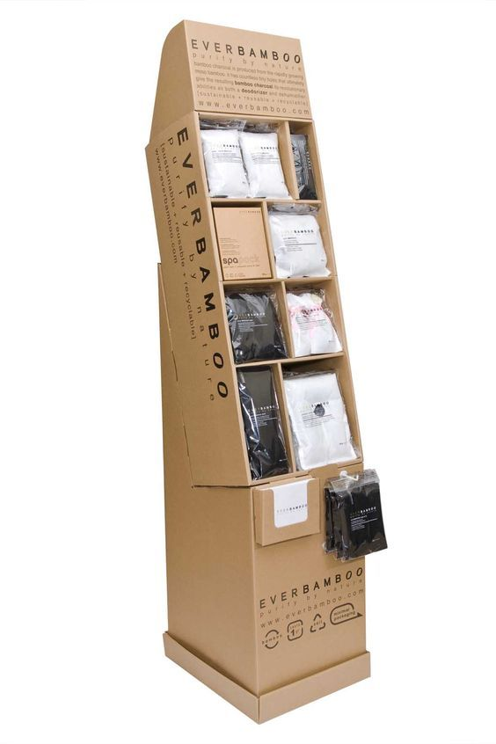
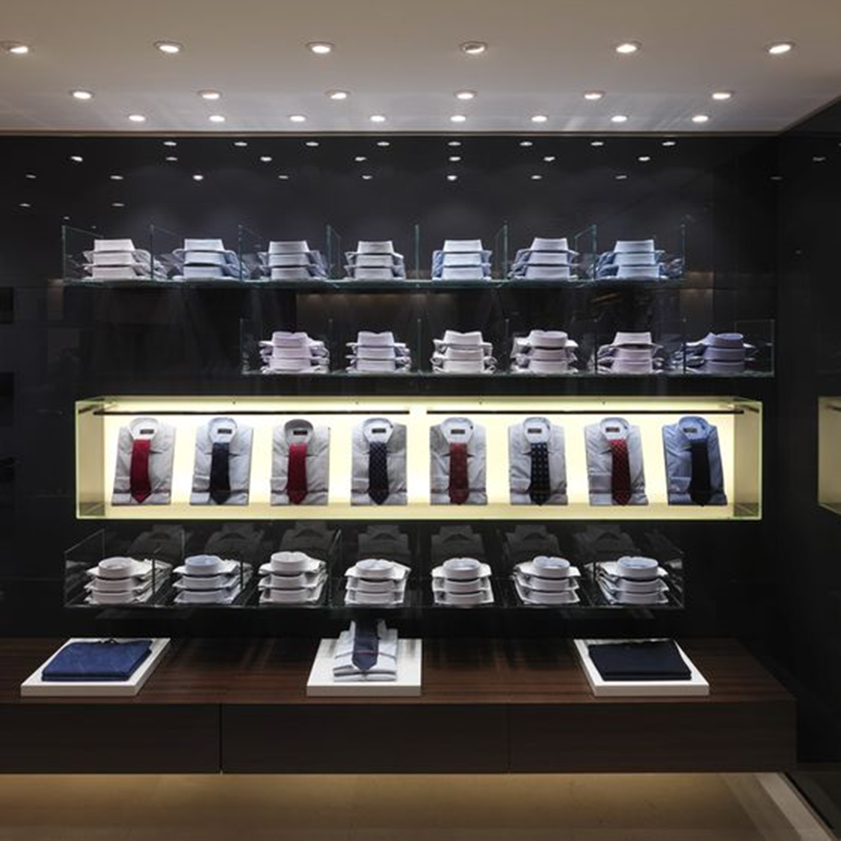

Today Super Market Tends…
Attractiveness during display

Slide 23
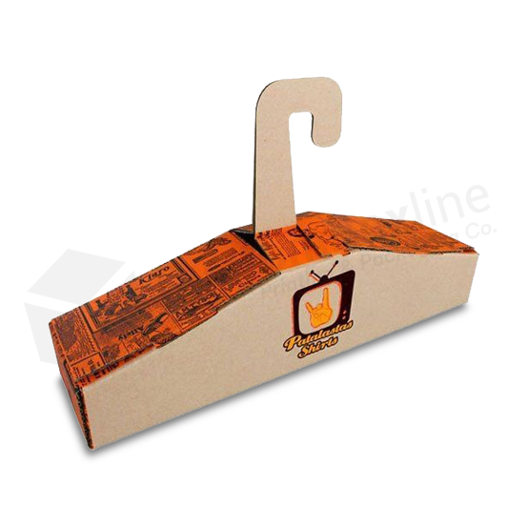
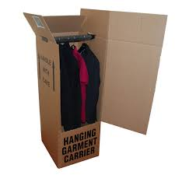
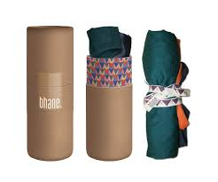
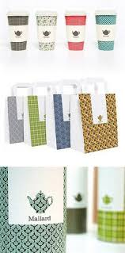
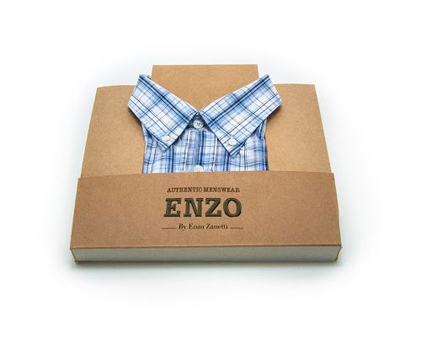
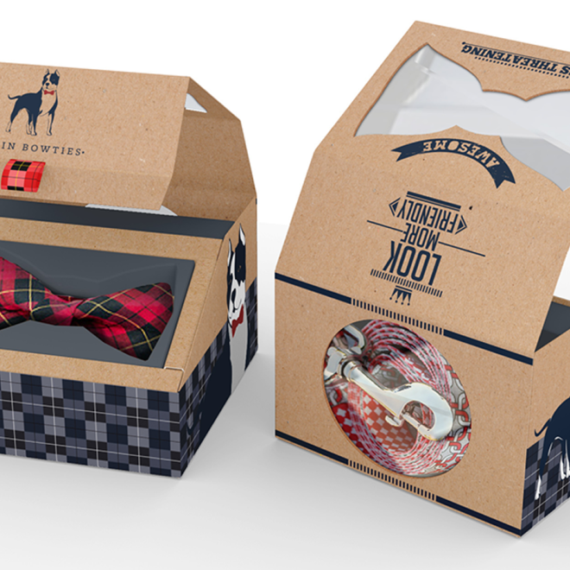

Consumer Packaging for Export of Apparel
Without folding it should be transportable
Reusable
Premium & uniqueness look
Must depict what the products inside; by graphic or design itself

Slide 24
Challenges Facing by the apparel / Textile Industry
Rise of Consumerism:
  Consumers today have become all powerful and with innumerable options coupled with swiftly changing fashion trends, it has become exhausting for retailers to keep pace and forge ahead of their competitors.
E -Commerce Effect
  Digital revolution has reshuffled the age old business model of buying and selling.
  Brick and Mortar shopping has become a thing of the past & brands like Amazon has taken over the virtual marketplace by offering a gamut of products and premium delivery service.
  In turn, consumers expect a similar hassle free shopping experience with every seller.
  Newer design challenge

Slide 25
Innovative Packaging for Apparel
Anti Fungal/Anti Microbial Packaging/ Sterilize Packaging
Ecofriendly Biodegradable Packaging
Innovation for self-seal bags or bubble bags with jiffy envelopes
Innovative Ziploc bag is also a good option.
Moisture and tear resistant Packaging
Protect aging UV light-
Intelligent Tagging with Tracking and Tracing feature
Label with customers address and a personalized message in the POD jacket of your courier bag.
Composite Packaging, Green Packaging- Organic Packaging
Customized packaging – personal touch
Using fragrance will add surprise for your customers.
Add a personal or handwritten thank you note with the product to elevate the shopping experience.
Choose colourful packaging that suits your brand and creates an impact so that you can earn some brownie points over your competitors use using 3-D printing for better feeling

Slide 26
Challenges Facing by the apparel / Textile Industry
Inventory Management:
  Inventory management is another challenge that the apparel industry encounters.
  Quick changes in fashion trends lead to changes in product branding and even packaging of the product has to be reassessed.
  Thus, apparel packaging is a phenomenon which is there and is there to stay. If you want customer retention, you need to study the various packaging options available.

Slide 27

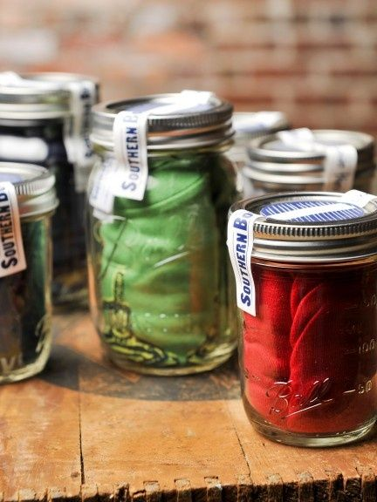

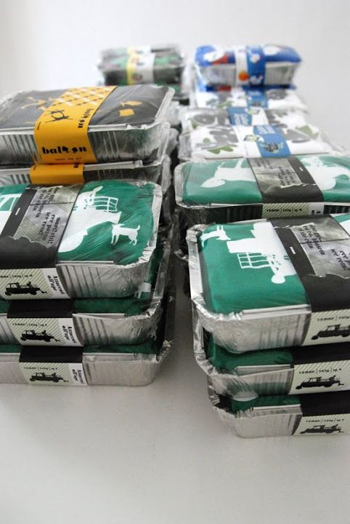
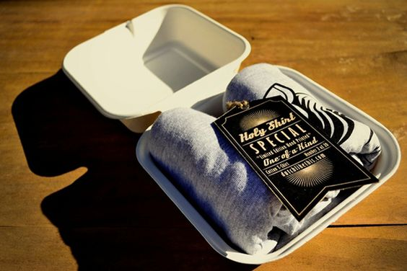
Need for Innovative Packaging
How to Differentiated Apparel Product

Slide 28
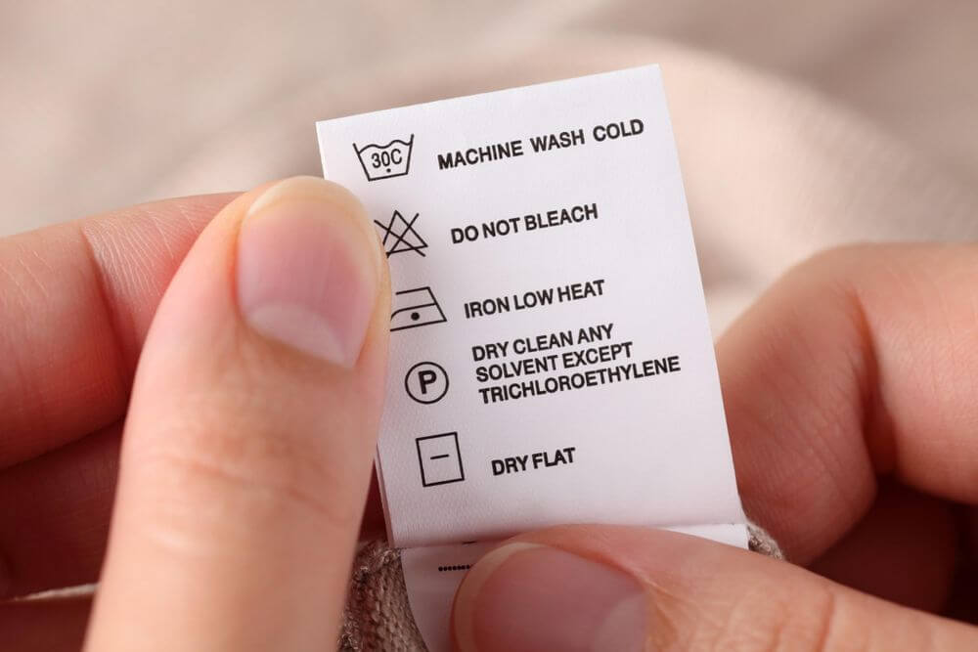
Garment Labelling Requirements for Apparel
Labeling Information
Types of Carton Packing:
Carton box number
Order number
Style, colour
Number of pieces in each colour and style
Total number of pieces
From address and To address
Contact number
BAR Code
Net weight of the carton box
Symbols for use
Among other important parameters, logos & letters of the product should be sufficiently large enough to read and printed in the same style as that used in complementary print and advertisement.

Slide 29
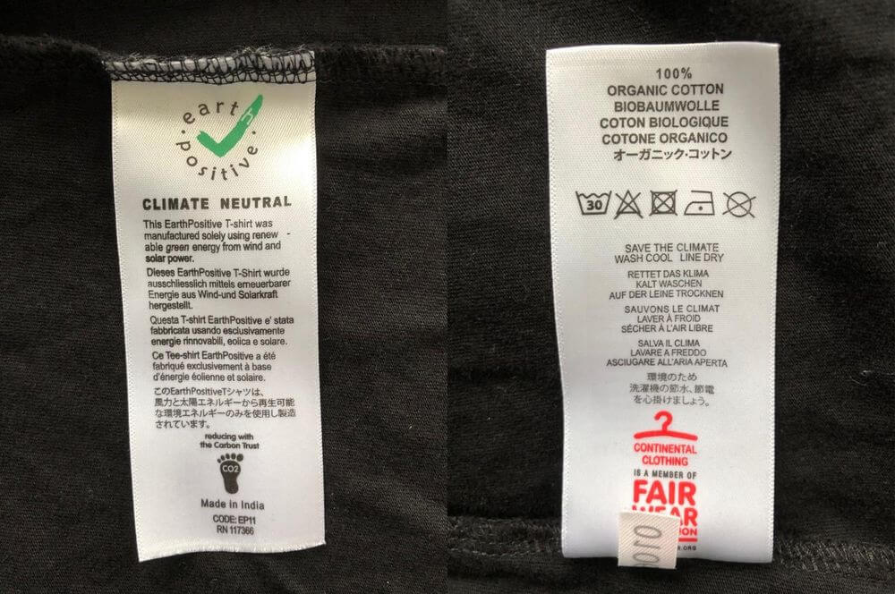
Garment Labelling Requirements for Apparel
To ensure regulatory requirement such as (FTC) to fulfill the compliance
Label establishes clothing & brand identity,
Provide instructions that help the customer for its best care & use
Certain independent organizations, such as the International Organization for Standardization (ISO), have their own labeling requirements that companies must follow if they wish to receive certification.

Slide 30
Garment Labelling Requirements for Apparel
Provide Consumer protection : While the garment label requirements of different countries more less similar in that these regulations are all in place for consumer protection purposes
Customer Specification: customer requirements need mention internationally.
A simple tag "Made in the India" will help to navigate the complex legal framework surrounding garment care information
Labeling certainly help to transform brand name into a household name all across the globe.

Slide 31
Regulatory Bodies Oversee Garment Labeling
The U.S. FTC and Customs & Border Protection (CPB) regulates the labeling requirements for textile & apparel products
FTC ultimately handles the administration of care labeling rules,
CPB handles the control & inspection of textile products entering the United States from other countries.

Slide 32
Labelling Regulations and Requirements
FTC and CPB regulates clothing label requirements to both domestic & foreign textile manufacturers of U.S. These requirements are summarized as:
  Fiber Content
  Country of Origin
  Washing and Care Instructions
  Manufacturer Identification
  Label Placement
Labelling Regulations and Requirements in the UK
  Fiber Content
  Country of Origin Label
  Washing and Care Instructions
  Brand Information and Style Numbers

Slide 33
Labelling Regulations and Requirements
Labelling Regulations and Requirements in the EU
  Fiber Content
  Country of Origin
  Washing and Care Instructions
  Manufacturer Identification
  Other Factor
Labeling Regulations and Requirements in Australia
  Fiber Content
  Country of Origin
  Washing and Care Instructions
  Manufacturer Identification
  Other Factor

Slide 34
Indian standards related to Cloth / Apparel industry
IS 12110 | 1987 | Glossary of terms used in apparel industry
IS 10106 : Part 1 Sec 3 | 1986 | Packaging code: Part 1 Product packaging,Section 3 Textiles, fabrics and allied products
IS 14463 | 1997 | Textiles- Packaging of cotton yarn and cloth for transportation in freight containers - Code
IS 1347 | 1972 | Inland Packaging of Cotton Cloth and Yarn

Slide 35
Apparel Industry Facing Problems ?
Is your packaging causing damage during transportation?
Is the packaging easy to carry and lightweight?
Does your packaging seem negligent?
Is your packaging easy to open?
Is your packaging material occupying too much space?
Do you really need that kind of material or can it be replaced?
Is your packaging an investment or a cost? Is your packaging creating the feel good factor?
Is your packaging exactly like every other fashion e-commerce vendor?
Are you even promoting your brand through your packaging?

Slide 36
Role of IIP
IIP can improve your packaging Design (Primary, Secondary and transport packaging and labeling)- thus minimize handling losses during transport & storage
Provides testing services to maintain the quality
Can provide assistance for making optimize specification to adhere Vendor Selection
Provide training session to make better understanding of packaging

Slide 37
Thank You…

